Slide 1


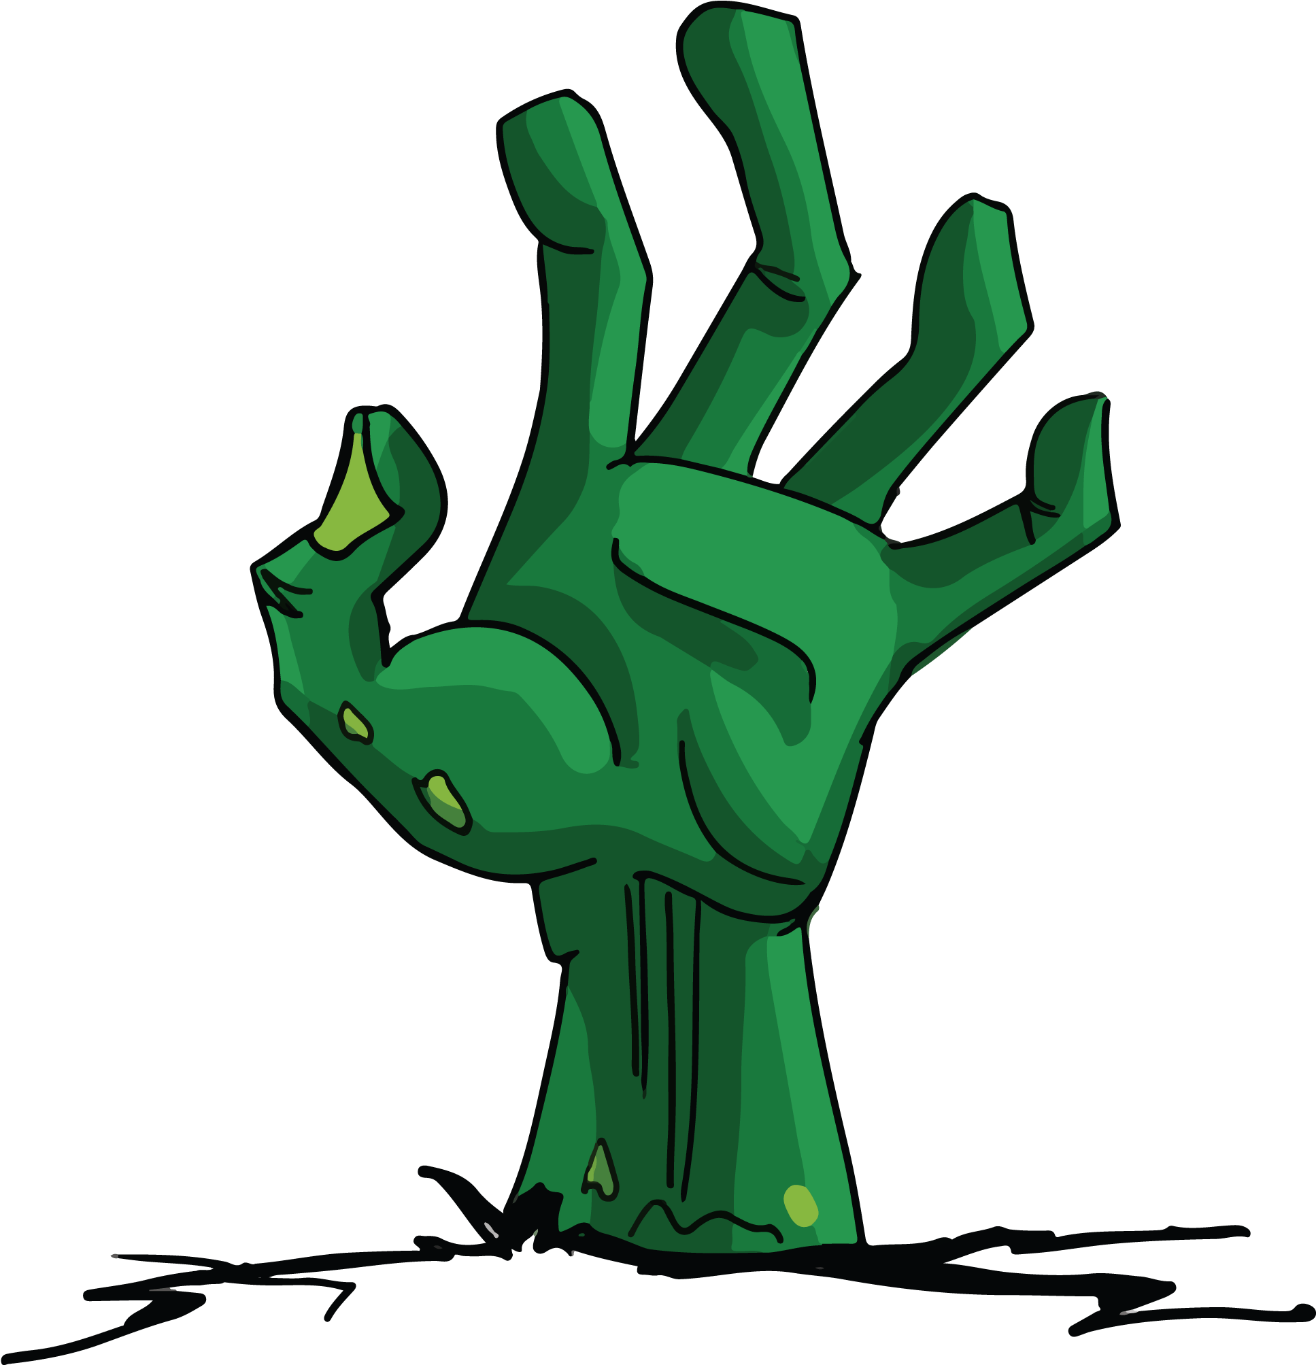
Necro Nursery
Team Abra-cadaver

Slide 2
Who are we?
Drew - Design Lead / Programmer
Brooke - Project Manager / Programmer / Art
Riley - Admin / Programmer
Nicholas - Marketing / Art
Jackson - Marketing / Programmer
Garrett - QA / Audio / Utility
Ian - Narrative
Carl- Narrative / Utility

Slide 3
Pitch
Take on your necromancy apprenticeship by helping your mentors raise the dead. It’s your job to get the living dead “sprouts” started before handing it off to the masters. Revel in the feeling of either bringing the dead back to life or making them so extra dead that even the masters can’t bring them back.

Slide 4
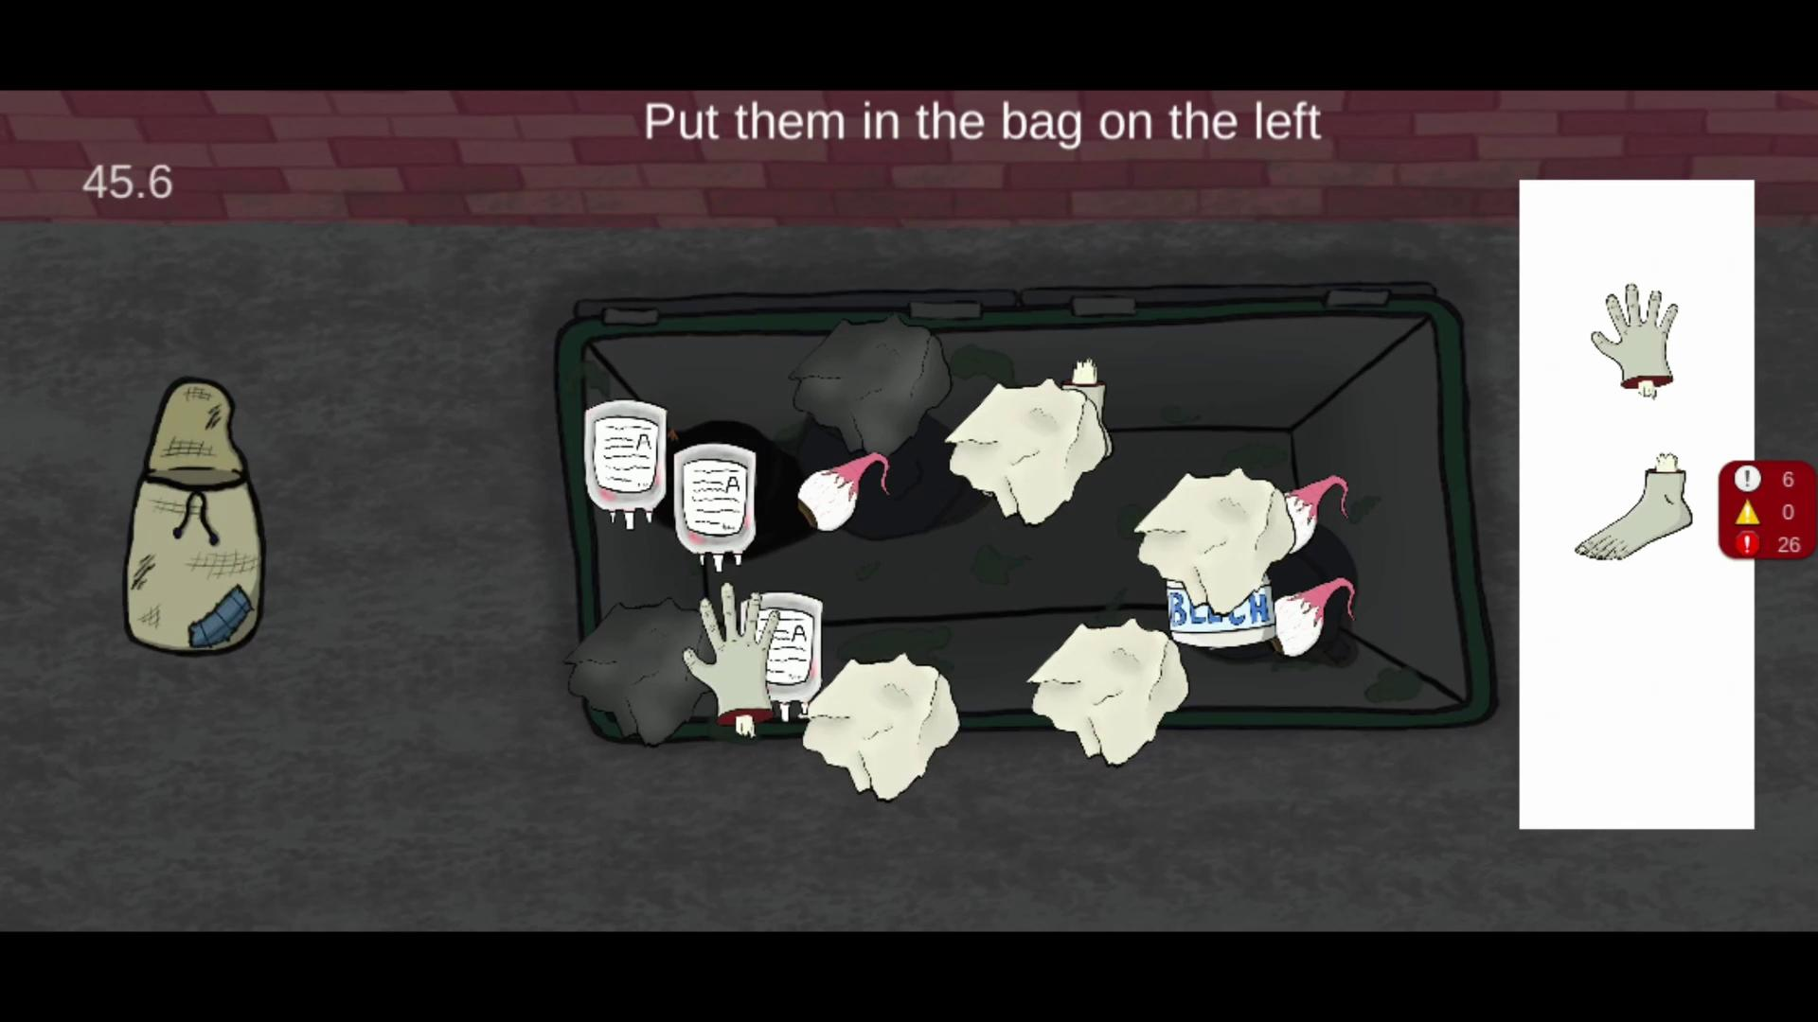
Gameplay

Slide 5
Narrative
Apprenticeship with Necromancers established
World Bible immensely fleshed out
History of the world
Our worlds definition of magic
Relationships between humans and necromancers
Tutorials and chat bubbles for narrative building inside game

Slide 6
Audio
Background Music
Main theme
Morgue
Merchant
Graveyard
Brewing
Mastermind
Ambient Noises and sound effects

Slide 7
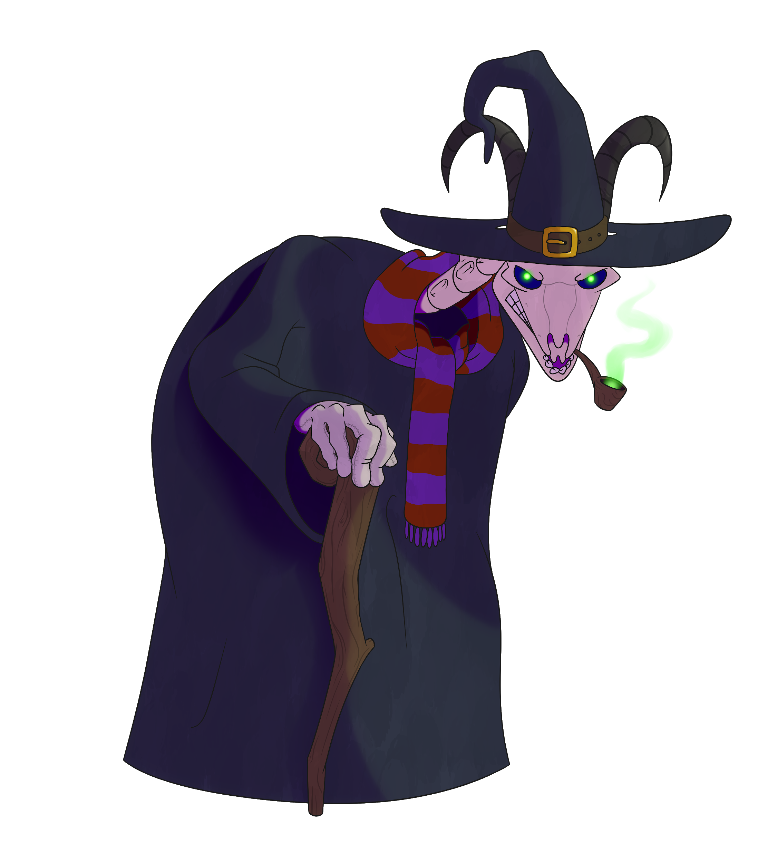
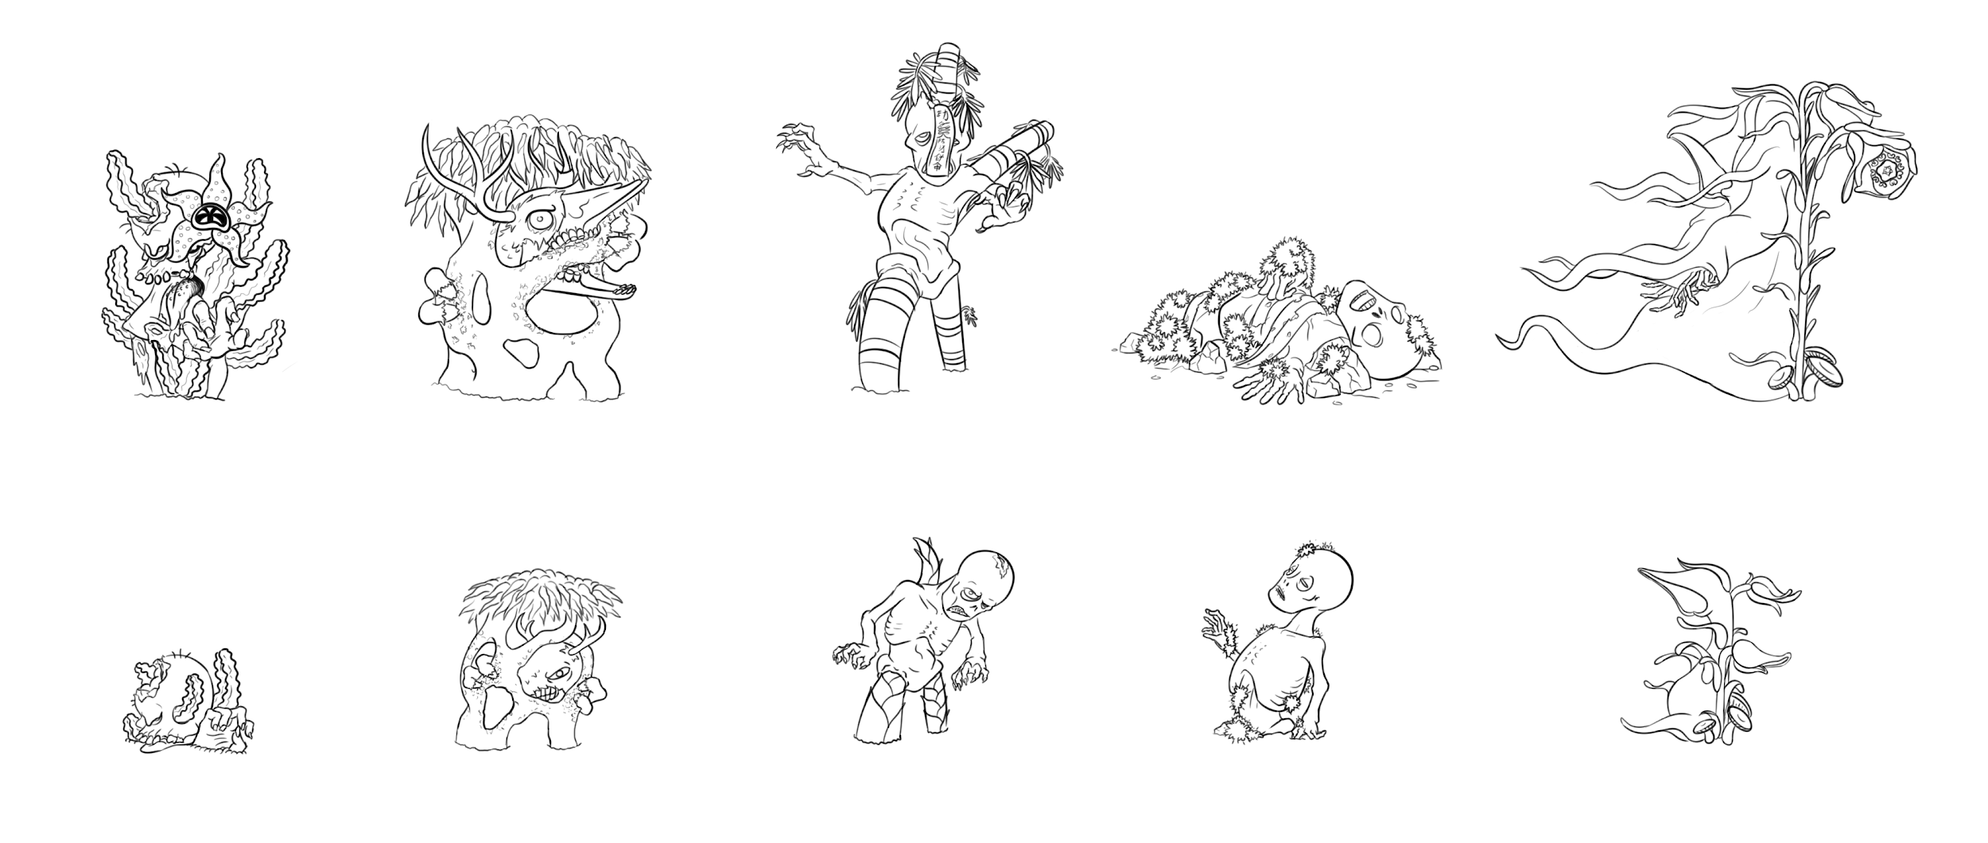

Slide 8


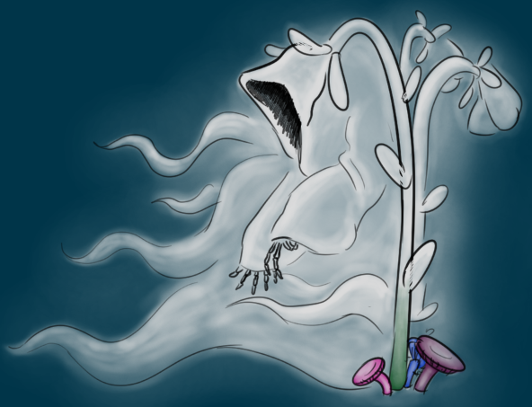

Slide 9
Programming
Tutorials & Dialogue boxes
Minigames
Morgue
Brewing
Mastermind
Plant Stages
Resource management
Save & load

Slide 10
What we learned
Drew - Being a leader and hands on experience with Unity
Riley - How to create and utilize Scriptable Objects in Unity
Jack - More experience working within Unity
Brooke - Working with mobile in Unity / Can’t help out as much as you want
Nick - Dividing the work can make it better
Ian - Not everyone is looking at building the world from the same perspective
Garrett - How to create soundtracks with minimal visual assistance
Carl - How to write within somone elses world/ Naritive

Slide 11
What I wish I knew
Drew - Definitively handling issues with teammates & being a “good” leader
Riley - That seemingly common and easy mechanics are not easy to implement
Jack - More about game programming before this class
Brooke - It’s hard to stay motivated when those around you aren’t
Nick - How to keep up productivity with numerous hindrances (research, etc.)
Ian - How to handle workload when personal events crop up
Garrett - Working on something other than your main role can be motivating
Carl - How to prioritize, what I need to work on

Slide 12
What we plan to do
Implement limited amount of seeds so that you have to buy more from the merchant
Add rare resources for mystery monsters
Add more monsters
Add unknown resources needed so that players can fail
Add experience bar & leveling up
Unlocking new minigames and monster when reaching certain experience levels
Add Elder and storytime narrative with Hints!
Update and revamp marketplace

Slide 13
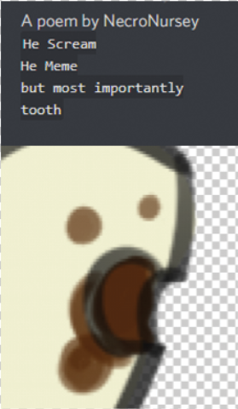
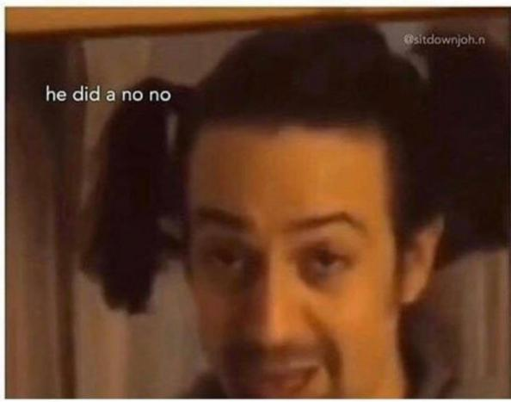
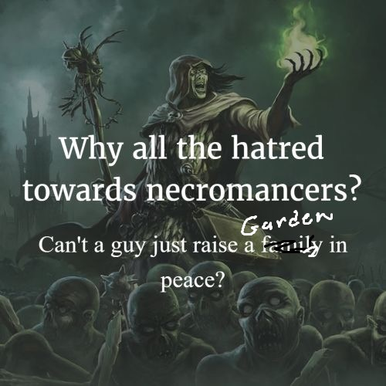
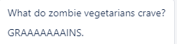
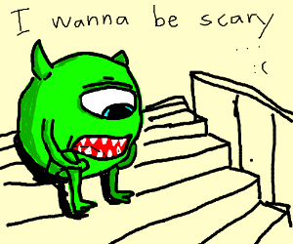
Questions?

